Slide 1
WELCOME TO MY PRESENTATION

Slide 2
INTRODUCTION
The Barisal river port has a recorded existence since the Mughal Empire. It was then called “Gird-e-Bandar”, a river station which was known for the trade of salt, spices, and woods. It was turned into Barisal Bandar (port) during the British rule after the town committee was established in 1869 and achieved municipal status in 1876.
EPIWTA was named as Bangladesh Inland Water Transport (BIWTA), which currently takes care of all related development, maintenance, and operations of inland water transport and of inland waterways in Bangladesh

Slide 3
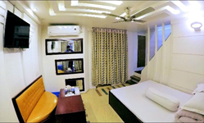
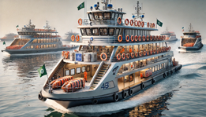
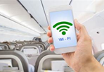
PRODUCT & SERVICES POSITIONING
LUXURIOUS AND COMFORTABLE
MODERN FLEET & SAFETY
WI-FI & ENTERTAINMENT
The most luxurious launches in Bangladesh, like the Sundarban-10 and Kirtonkhola-10, offer high-end interiors with features such as VIP duplex business class cabins, food courts, and even coronary care units (CCU). Sundarban?10, a 300-foot, three-story vessel, is equipped with modern amenities like a lift, radar, and GPS
The Modern launches in Bangladesh focus on safety and innovation, featuring GPS, radar, and advanced navigation systems. These vessels are equipped with life-saving measures like lifeboats, life vests, and well-marked safety ~ 11 ~ instructions.
Provide Wi-Fi services and entertainment systems onboard to keep passengers engaged

Slide 4
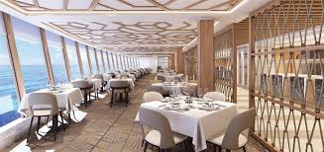
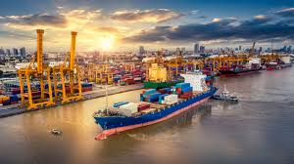

PRODUCT & SERVICES POSITIONING
ONBOARD DINING
CARGO SERVICES
EASY BOOKING & CUSTOMER SUPPORT
Offer quality food options (local and international), which can be an attractive service for long trips
Position the launch as a reliable option for carrying goods and cargo between Barishal and Dhaka.
Develop an easy-to-use online booking platform and responsive customer service for ticket bookings and inquiries.

Slide 5
CHALLENGES & OPPORTUNITY
Market Differentiation
Reputation Management
Differentiate the lounch or ship from the competitor in the terms of service ,look make it more appealing from customer point of view , more efficient and update enjine system than the competitor
Reputation is a big issue for a ship company so they should serve properly to the customer, as well as handle negative feedback with great concern, take complain serious and solve customer problem
Unique Selling Proposition
Design and Branding
just try to evaluate and highlight what makes the ship or the experience unique, whether it’s luxury, outer look ,service , employee behavior or cultural significance.
Develop a comprehensive branding strategy that includes a attractive logo, color scheme, and messaging that connect with the target audience.

Slide 6


FUTURE GOALS
Short Term Goals
Increase the number of launches to meet the demand. Improve the quality of the launch transport service. Increase the frequency of trips to attract more passengers. Implement safety measures to ensure the safety of passengers.
Long Term Goals
Expand the fleet of launches to reach more destinations. Establish a permanent terminal for launching. Introduce environmentally friendly technology to reduce the carbon footprint. Offer tourist packages to encourage tourism in Barishal

Slide 7
THANK YOU

